Slide 1
The Center for Aquaculture & Biotechnology

Slide 2
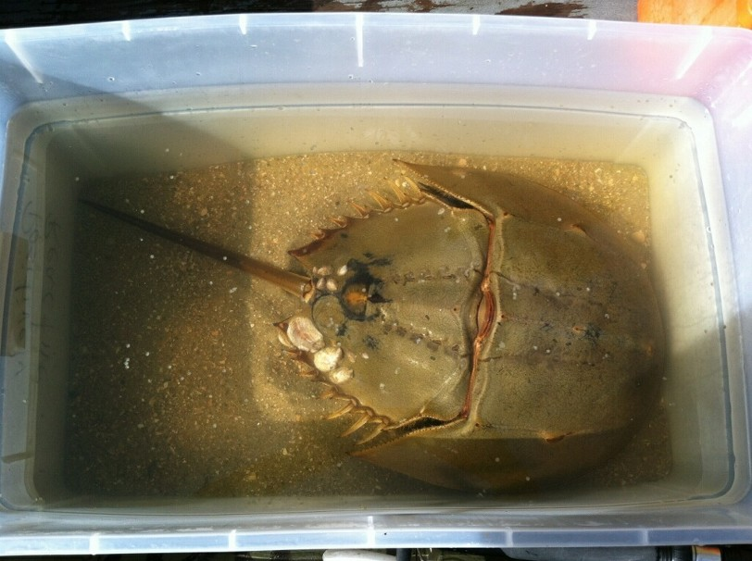
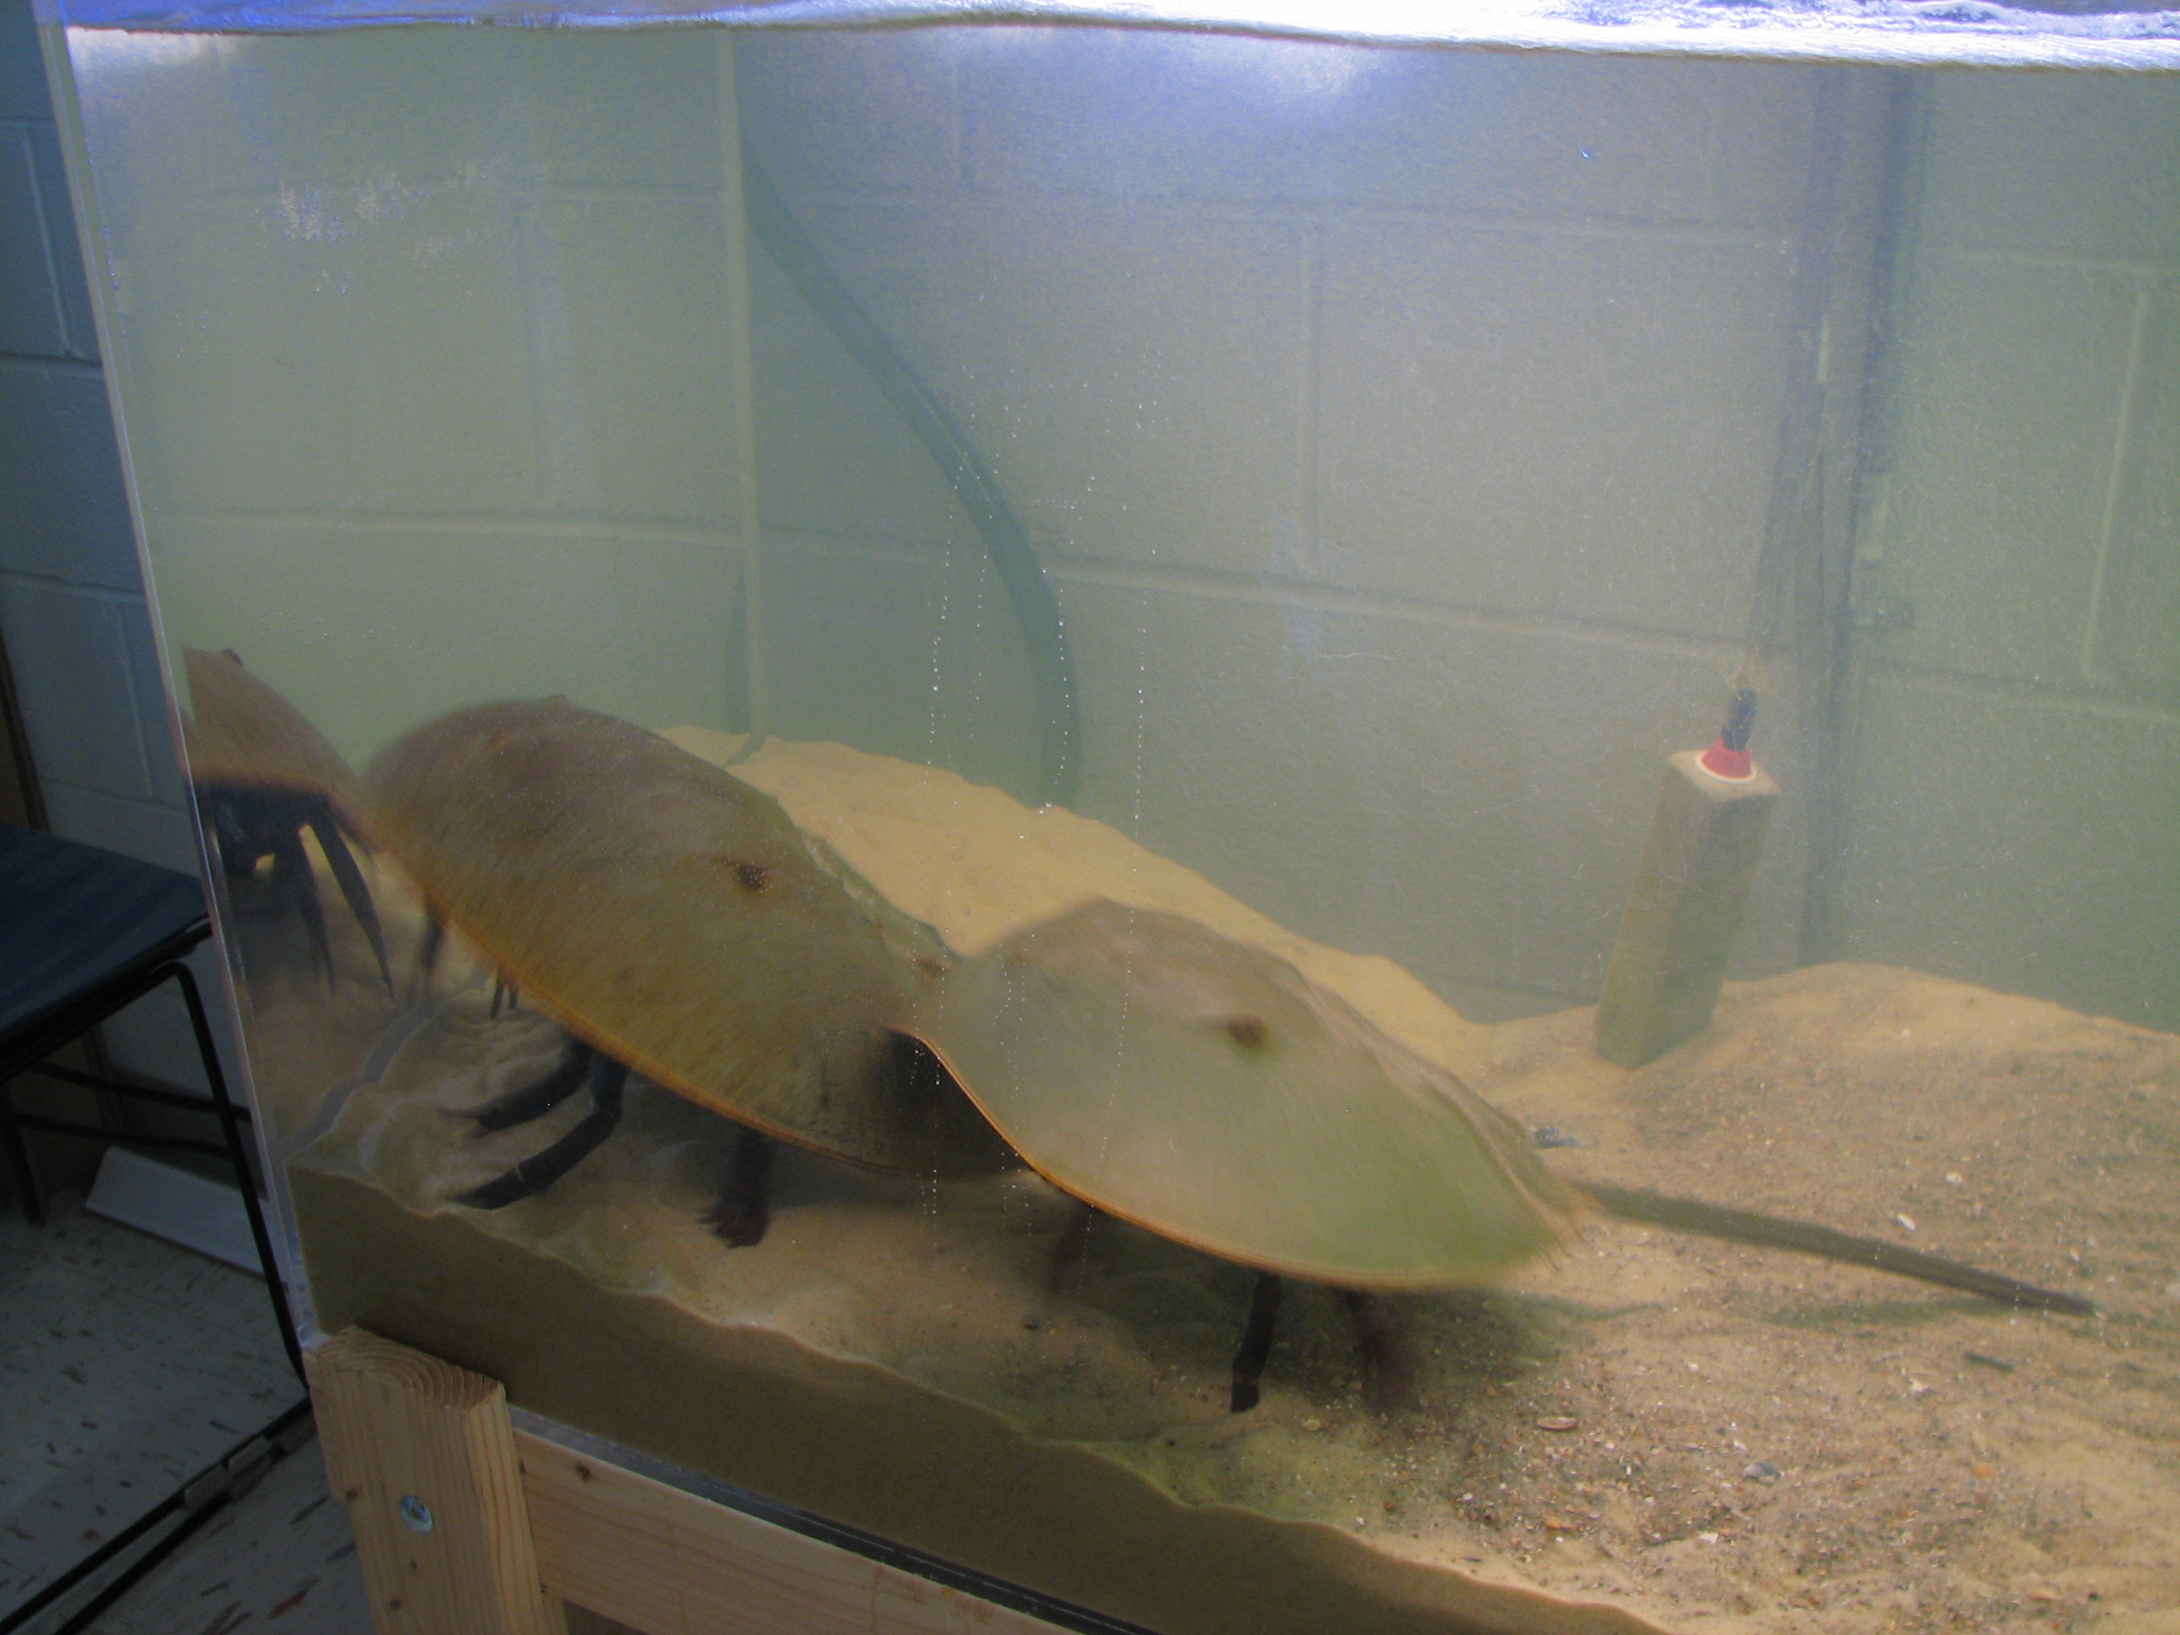
Our New Adopted Horseshoe Crabs Received 28th of May 2015
After a long trip from the mouth of the Cape Fear River from a private donor’s boat
Gertrude and Heathcliff made their way to our Center

Slide 3
They are getting acclimated to their new surroundings for spawning
Gertrude →
← Heathcliff

Slide 4
The surprise addition to our Center were juvenile horseshoe crabs! Otherwise known as larvae…

Slide 5
We will document the larval journey in their new home, and share with you!

Slide 6
Credits
The team effort, thanks to:
Various Aquaculture Students
John Baka
Chad Gray
Cindy Hickman
Kim Jones
Author: Michelle Sabaoun

